Slide 1
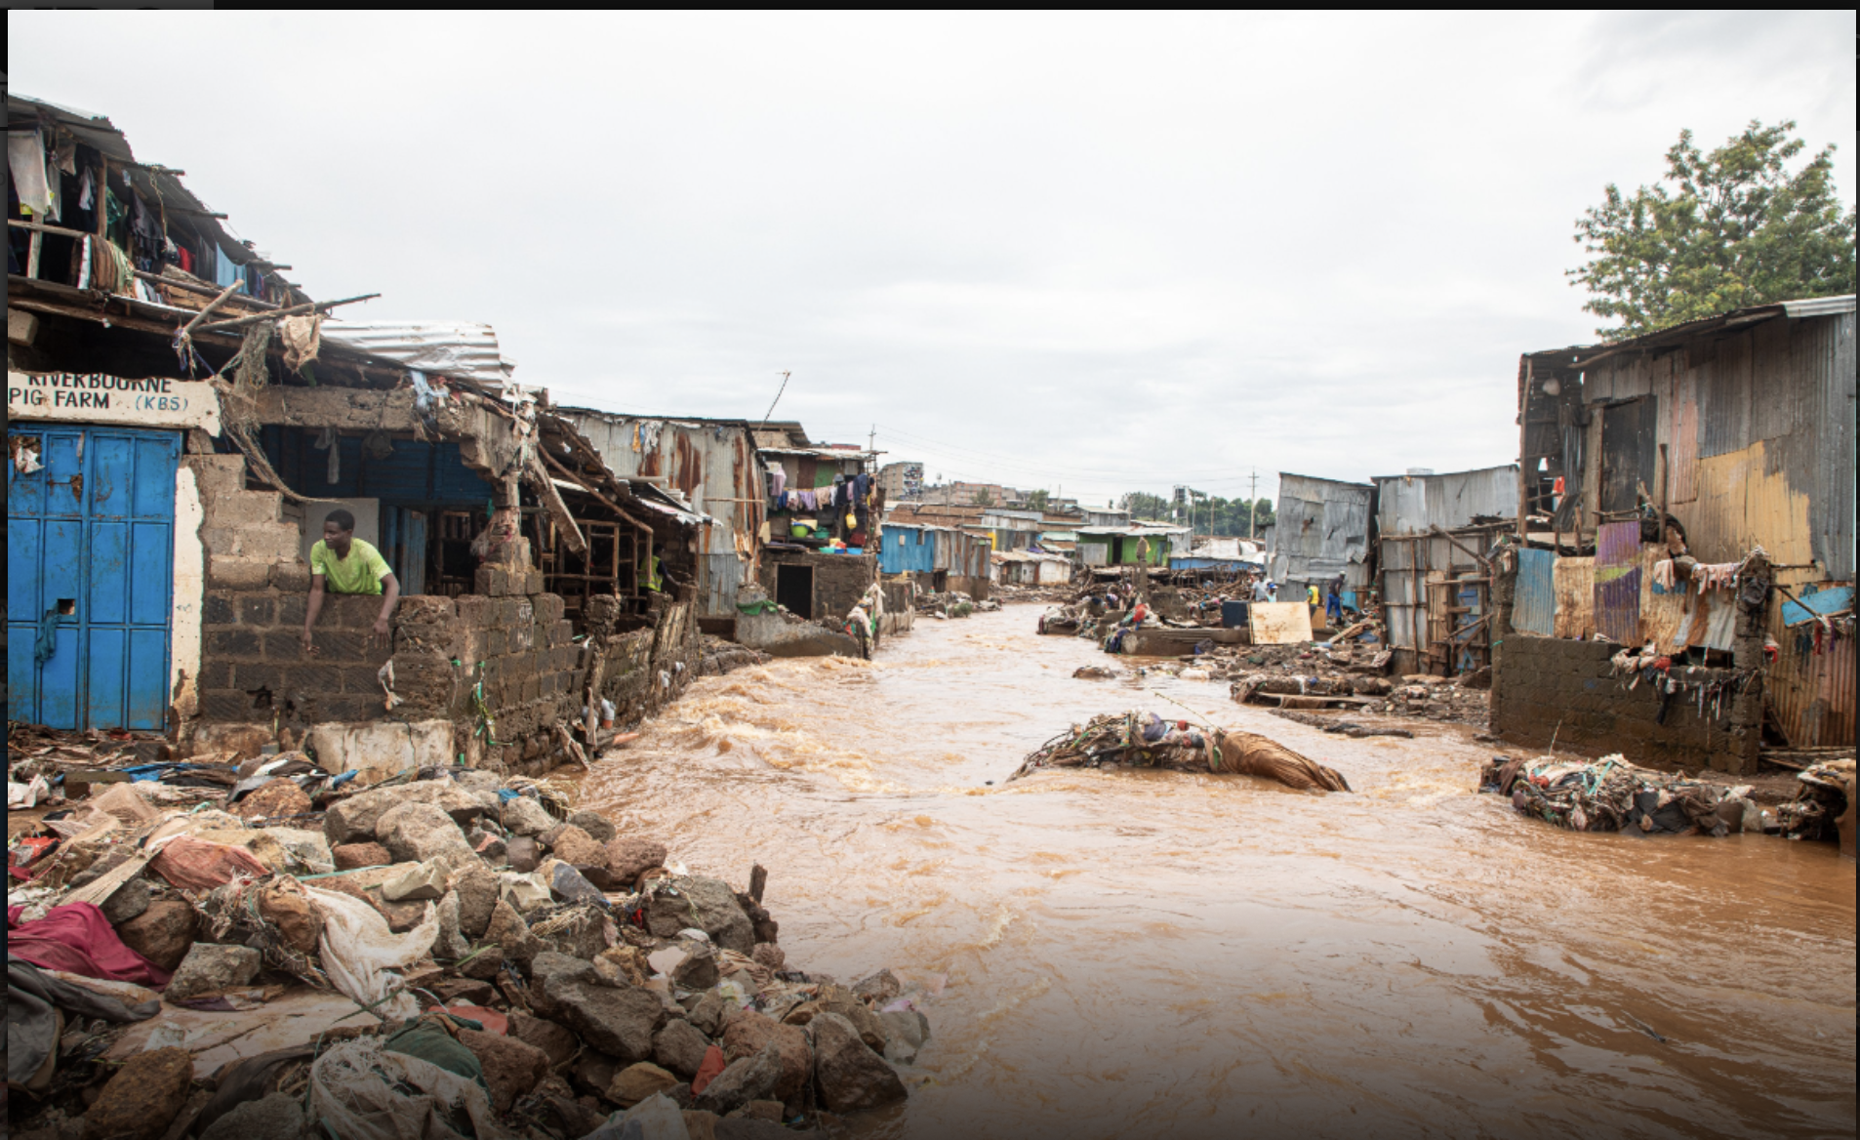
Deep Learning Approaches to Flood Forecasting Kampala, Uganda
Dai Wuran UCID 30248872
De-Graft Godwyll UCID 30263217
Fre Ashal UCID 30231900
Jalelle Dinka UCID 30244336
Kwadwo Asare-Menako UCID 30256351
Leanne Lane UCID 00890466
Mahweer Kumar UCID 30259639
Navneet Robin UCID 30264490
Group 10
December 5, 2024

Slide 2
Land Acknowledgement
The University of Calgary, located in the heart of Southern Alberta, both acknowledges and pays tribute to the traditional territories of the peoples of Treaty 7, which include the Blackfoot Confederacy (comprised of the Siksika, the Piikani, and the Kainai First Nations), the Tsuut’ina First Nation, and the Stoney Nakoda (including Chiniki, Bearspaw, and Goodstoney First Nations). The City of Calgary is also home to the Métis Nation of Alberta (Districts 5 and 6).

Slide 3
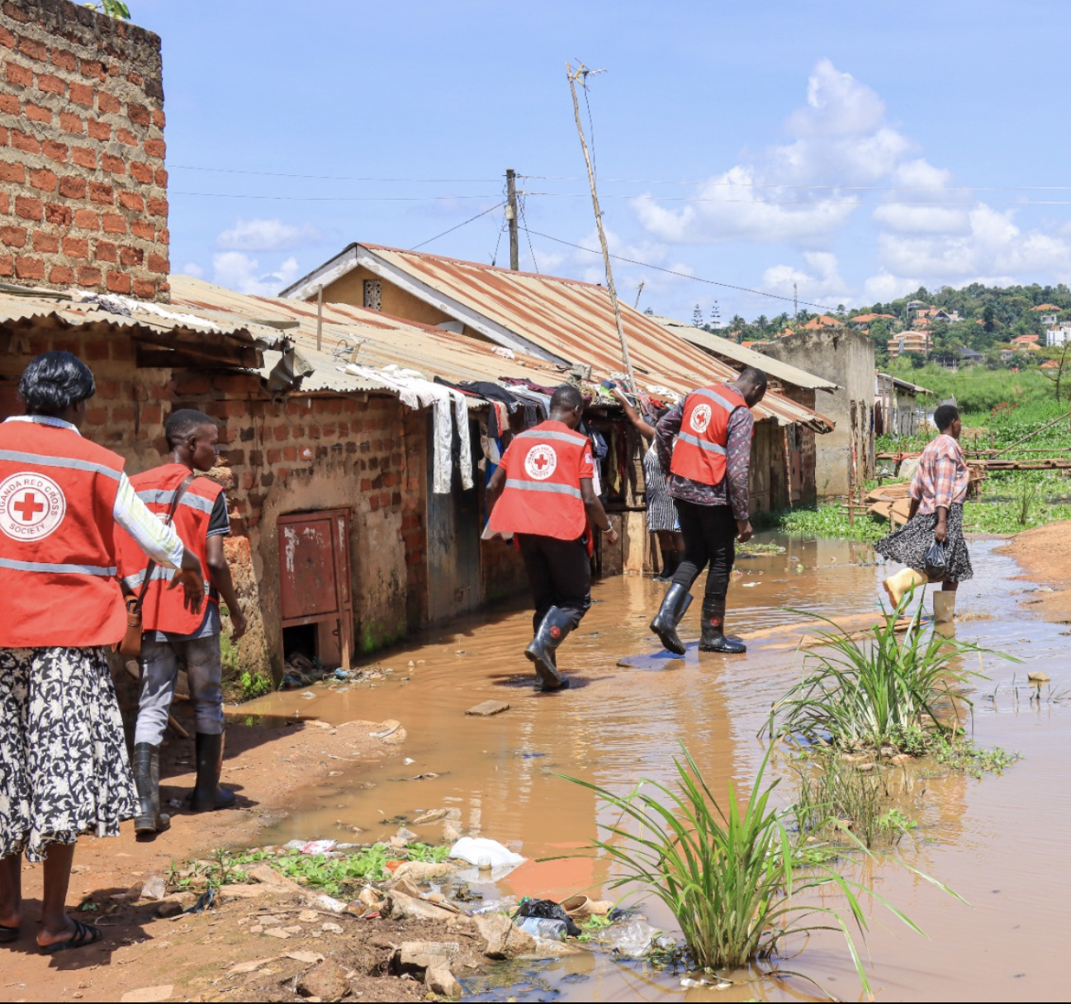
Introduction
How did we choose our project?
Real world problem
Humanitarian in nature
Gap in the existing emergency response framework
Kampala, Uganda
Flooding is endemic
Loss of life; displaced families; waterborne illness
City of 4 million -> 21 million in 2040
Two rainy seasons (March/May & Sept/Dec)
GloFAS model - ineffective for urban flash floods
Data Availability
Ugandan rainfall data –-> unavailable
Stream gauge data –-> no data
Purpose: To develop a machine learning-based, early warning system for predicting flash floods and enhancing public safety in Kampala

Slide 4
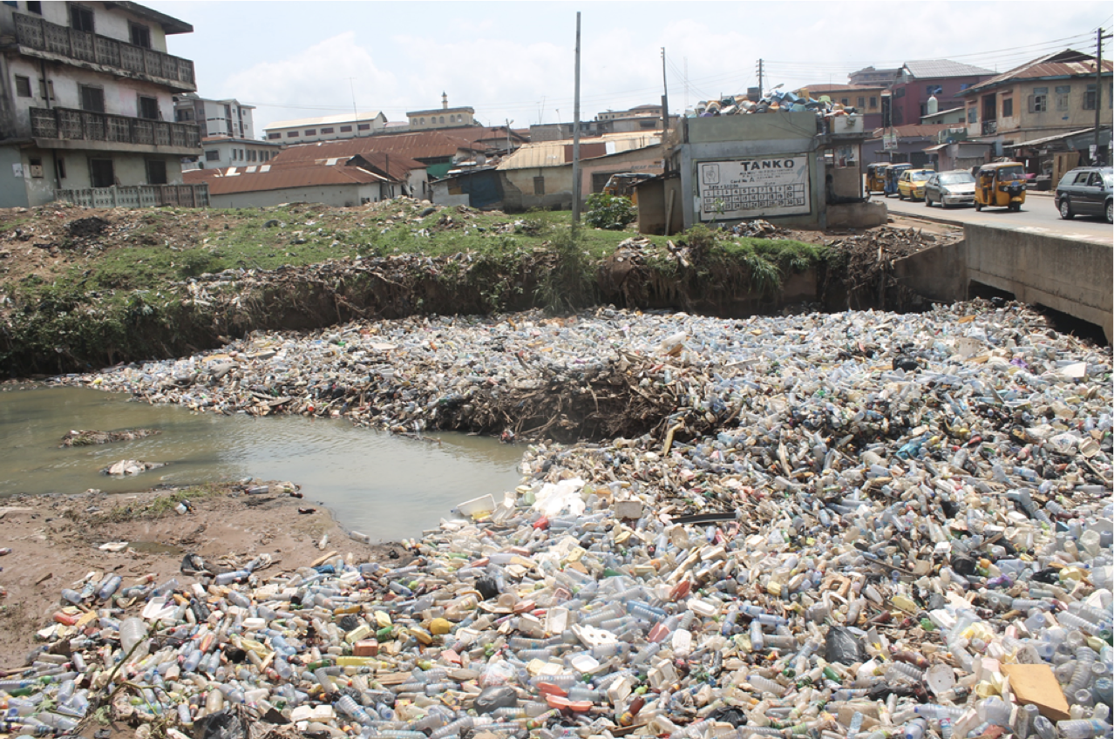
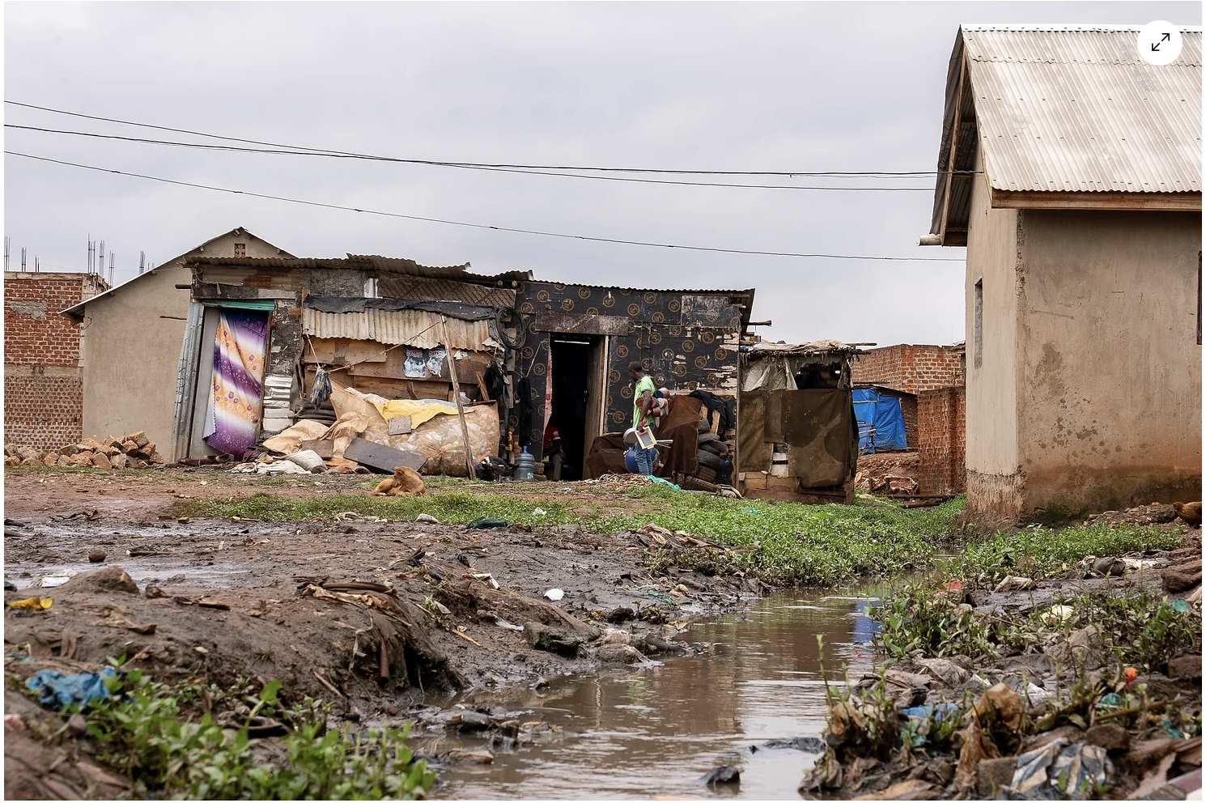
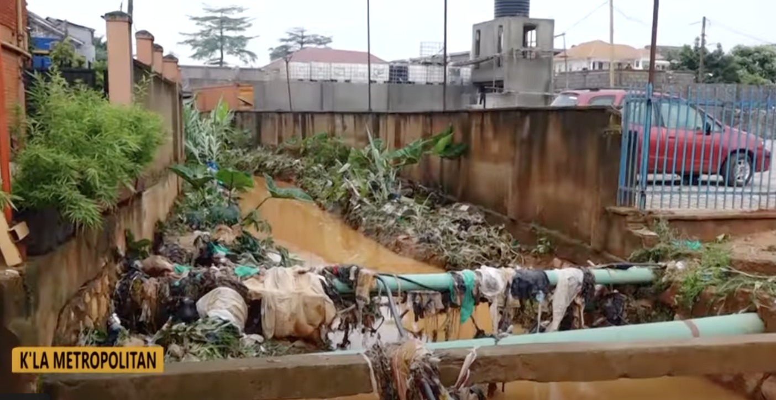
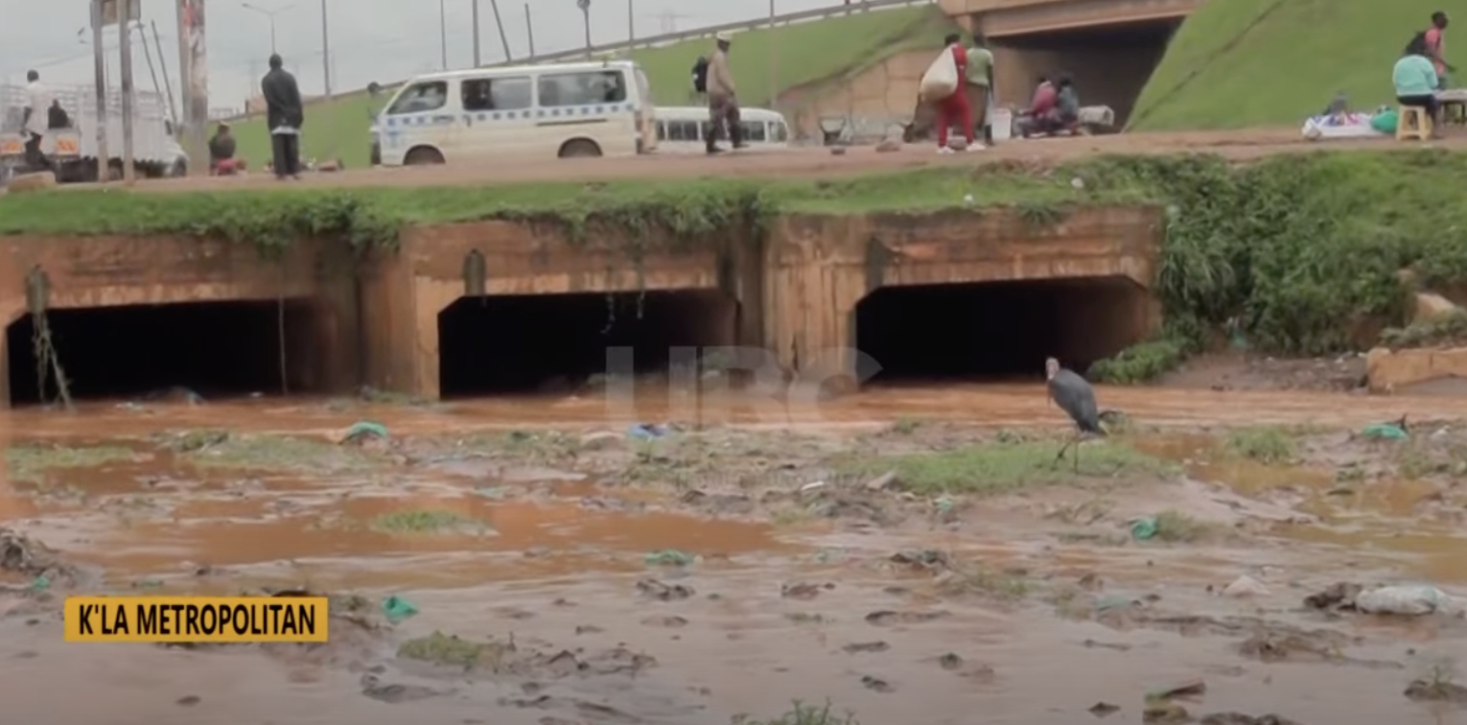
Why does Kamapala Flood ?
Urbanization (impervious footprint)
Pluvial flooding (overland or flash flood)
Undersized/aging infrastructure (1950s)
Improper waste disposal (plastics)
Inadequate maintenance (siltation; reduced hydraulic capacity)
Slums situated in floodplains

Slide 5
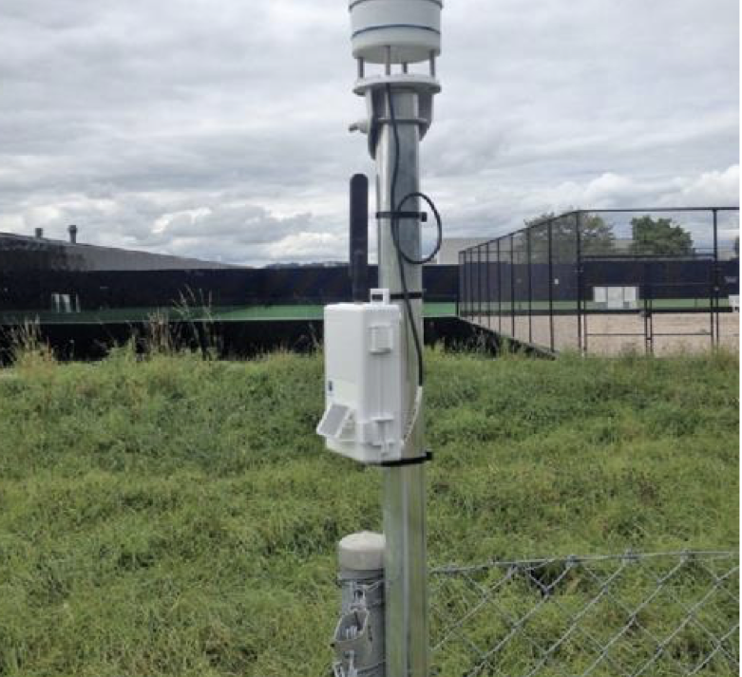
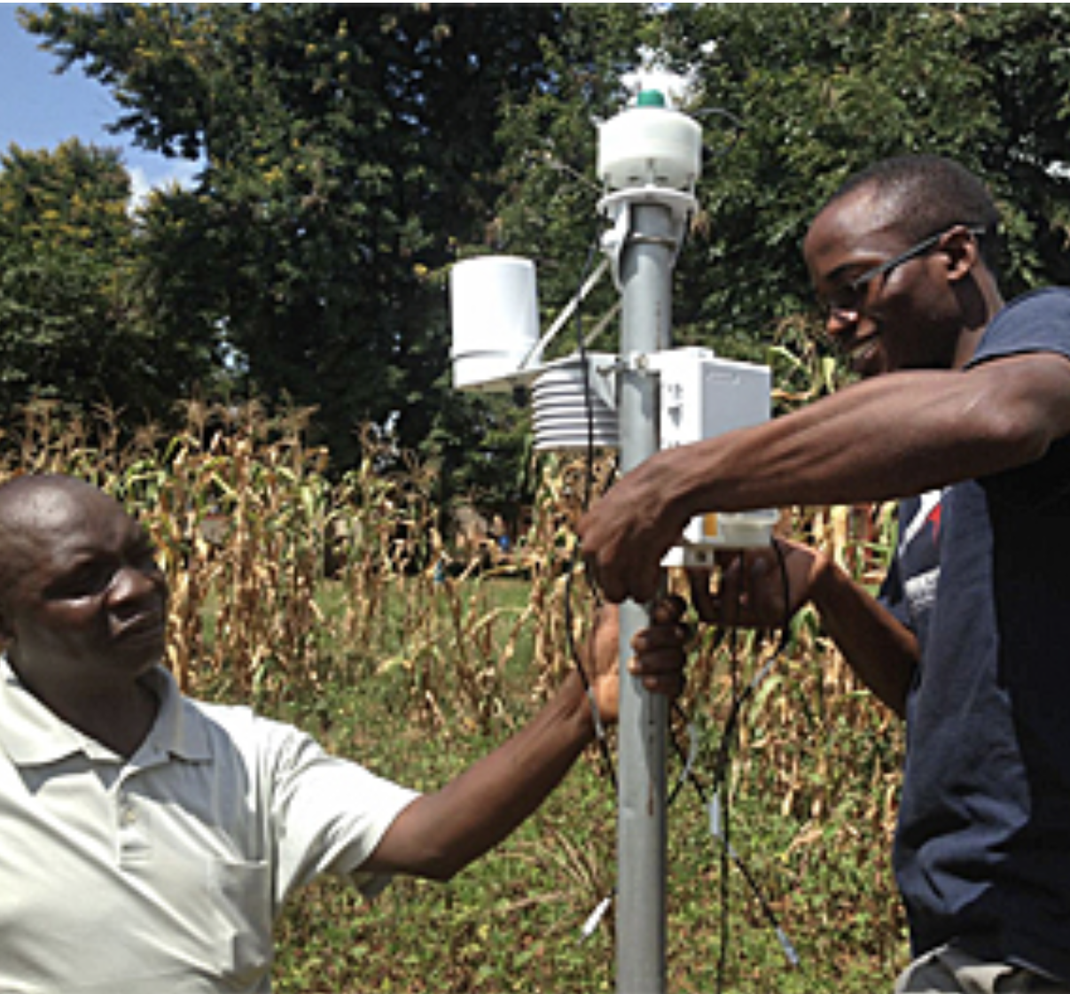
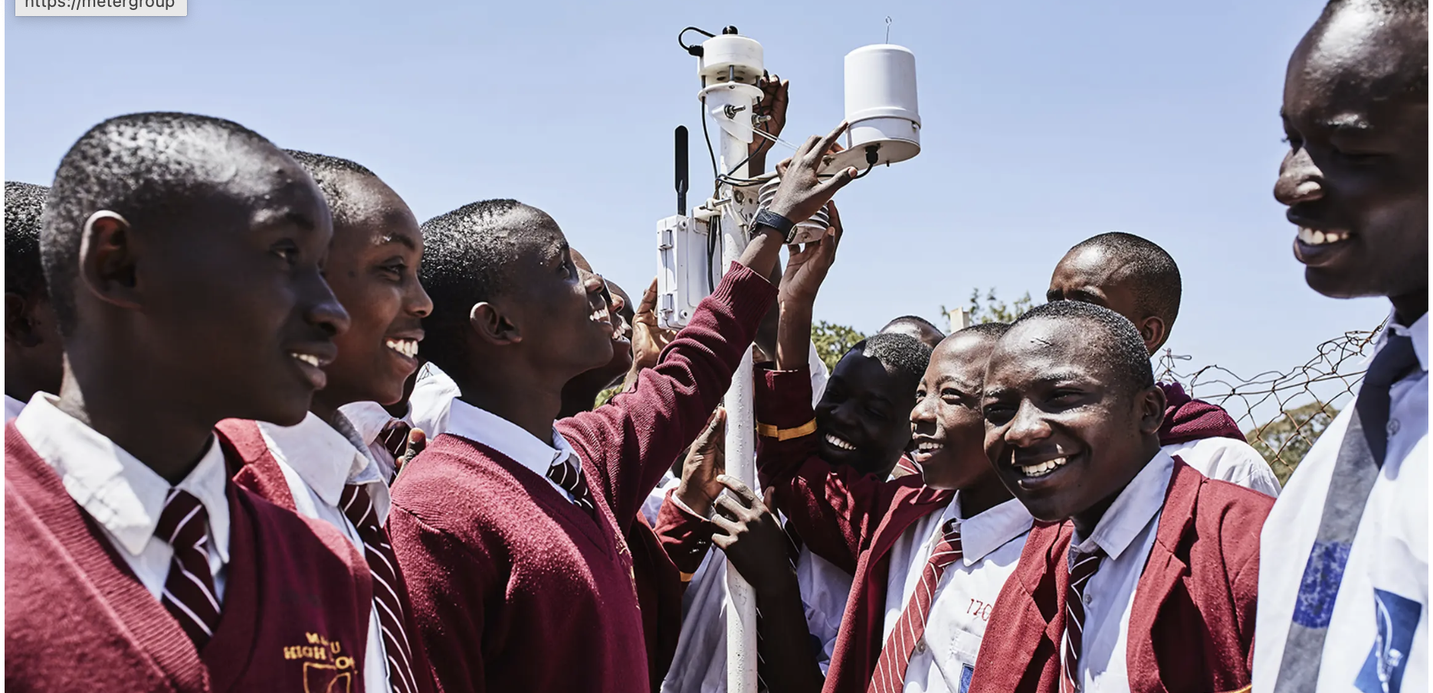
Data Collection
Data Collection from TAHMO (Trans- African Hydro-Metrological Observatory)
Collected data from 5 stations
Precipitation, Humidity, Max Temperature, Min Temperature, Mean Temperature
IoT sensor used to collect real time data .

Slide 6
Literature Review
As disasters lead to a huge losses, Internet based technology could aid in monitoring floods (Mitra et al. 2016).
Katonga river periodically encounters a wide range of severe flooding events and acute natural circumstances, contributing to large-scale damages and harmful effects (Sidek et al. 2020).
The IoT approach is used for data collection from sensors and ANN is used for data prediction. A flood disaster warning system on Go Research (Abdullahi et al. 2018)

Slide 7
Literature Review
Concurrently, lower katoong basin flooding was studied by Kumar & Yadav (2021), who employed artificial neural networks (ANNs) to model the phenomenon on a real-time data collection basis.
Research Gap: This study uniquely incorporates hourly meteorological and hydrological data with an LSTM model to address the gap in precision and real-time forecasting, which existing models fail to achieve effectively

Slide 8
Methodology
Data collection: hydrological and meteorological data
Humidity
Precipitation
Maximum temperature
Minimum temperature
Mean temperature
Data preprocessing:
Merged 5 stations data into 1 to represent the whole Kampala
Imputed missing values and removed outliers to ensure data quality
Labeled the data by 7 flood events
Standardized variables through normalization for uniform scales

Slide 9
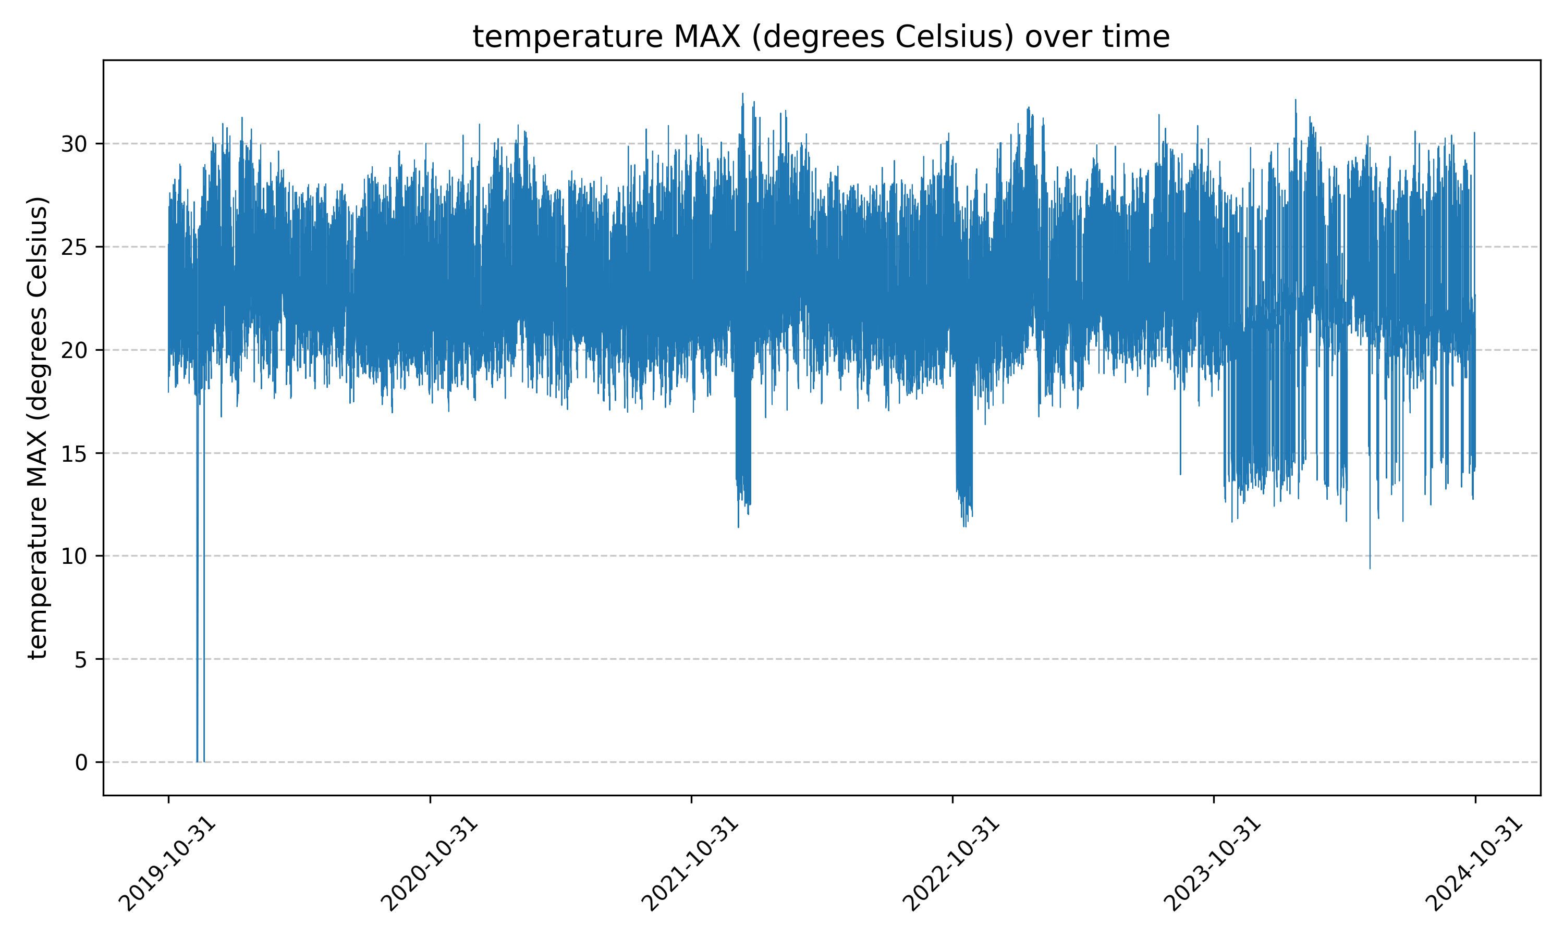

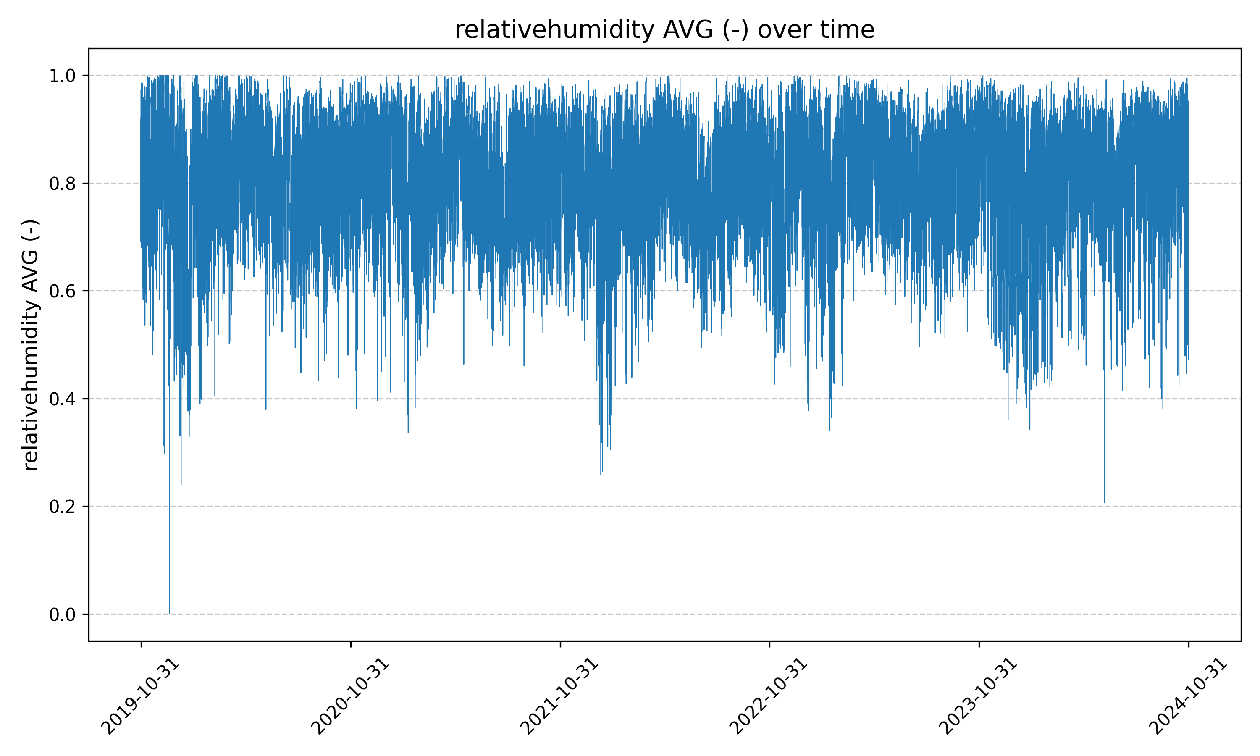

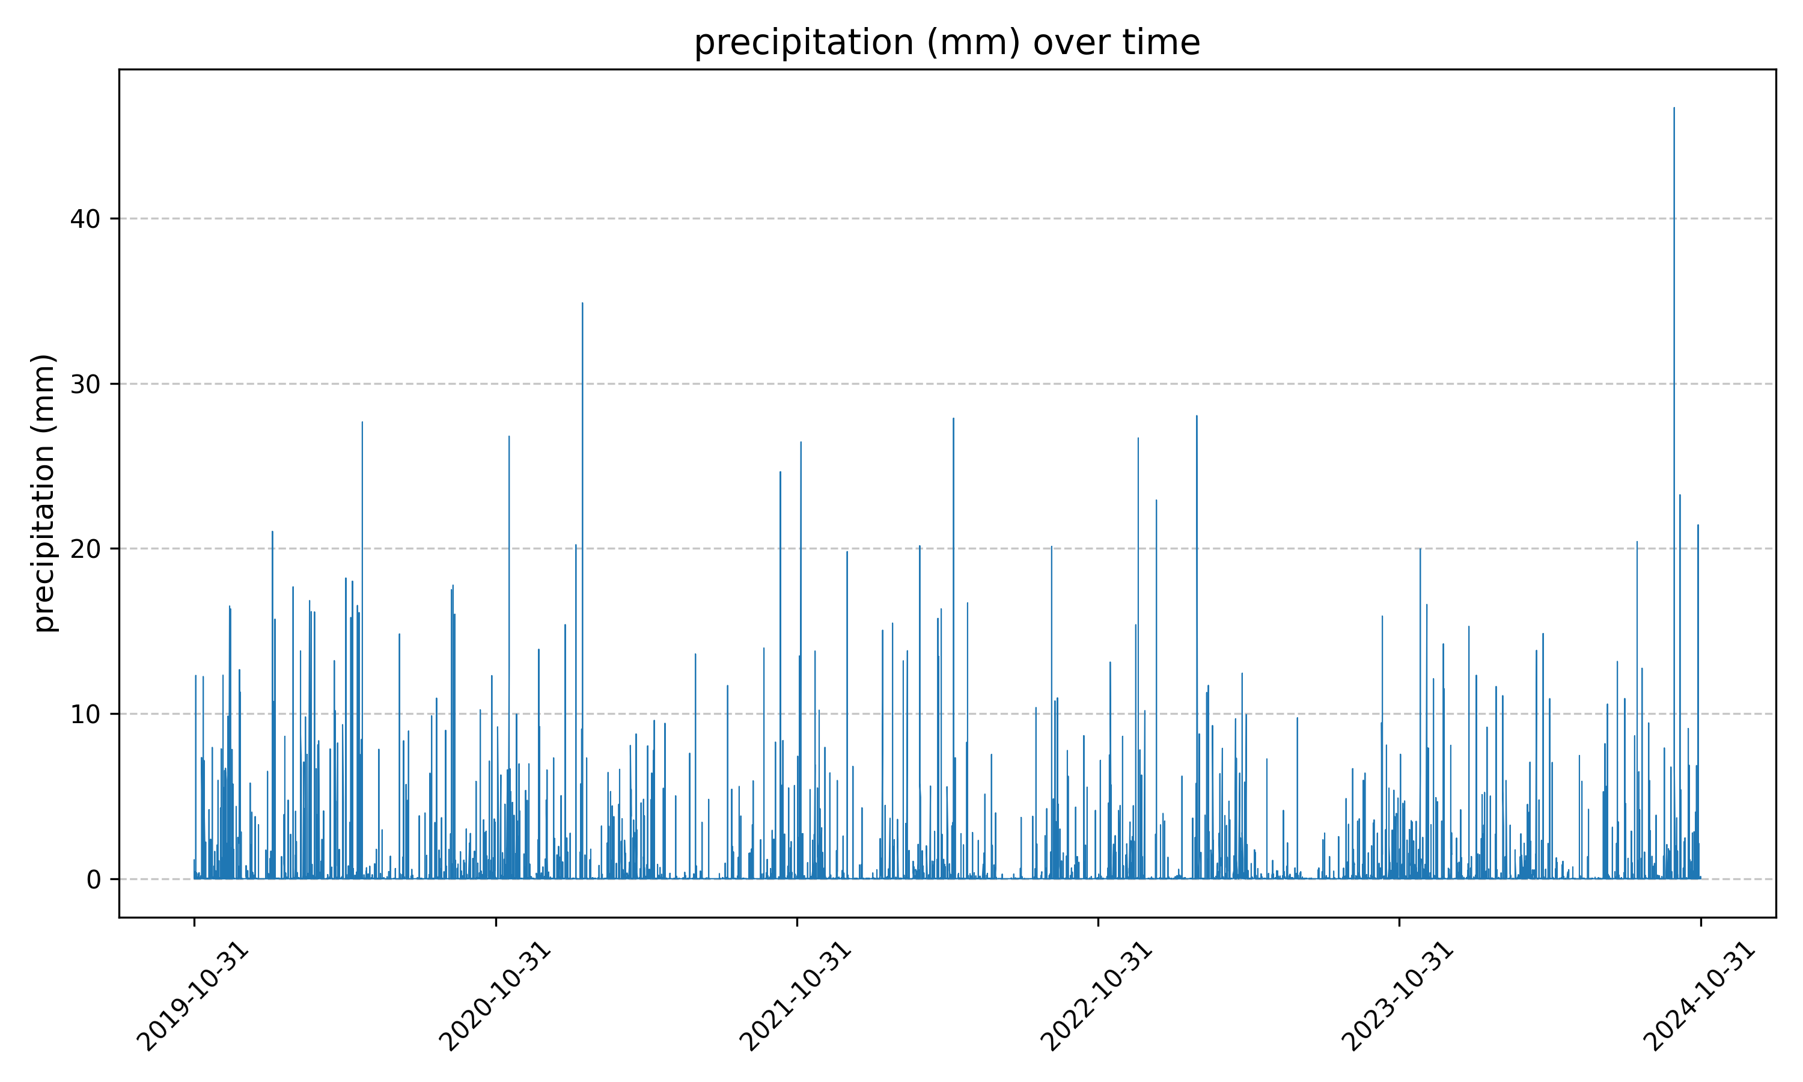
Methodology

Slide 10
Methodology
Model selection
Recurrent Neural Networks (RNN):
Designed to process sequential data with temporal dependencies.
Suitable for modeling flood predictions based on time-sensitive data.
Challenging to train on long sequences.
Long Short-Term Memory (LSTM):
Improved version of RNN, capturing long-term dependencies.
Mitigates the vanishing gradient problem, making it ideal for hourly data.
Better at identifying short-term trends, crucial for sudden flood predictions.

Slide 11
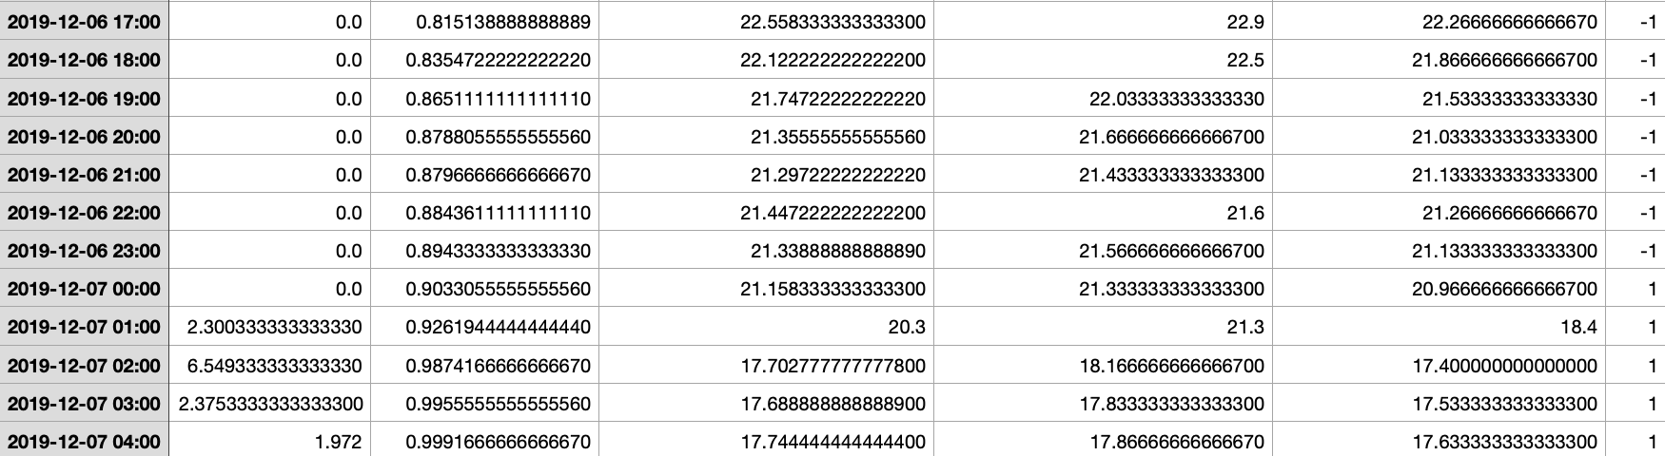
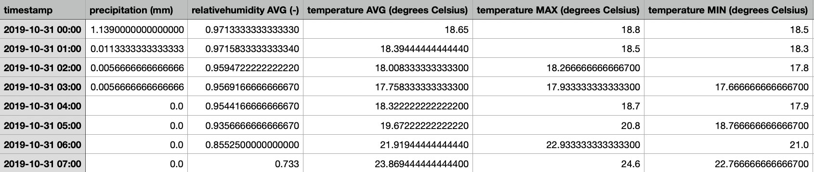
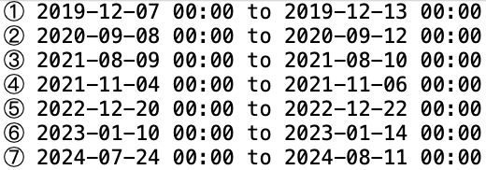
Coding – Data Processing
Features
7 Floods :

Slide 12
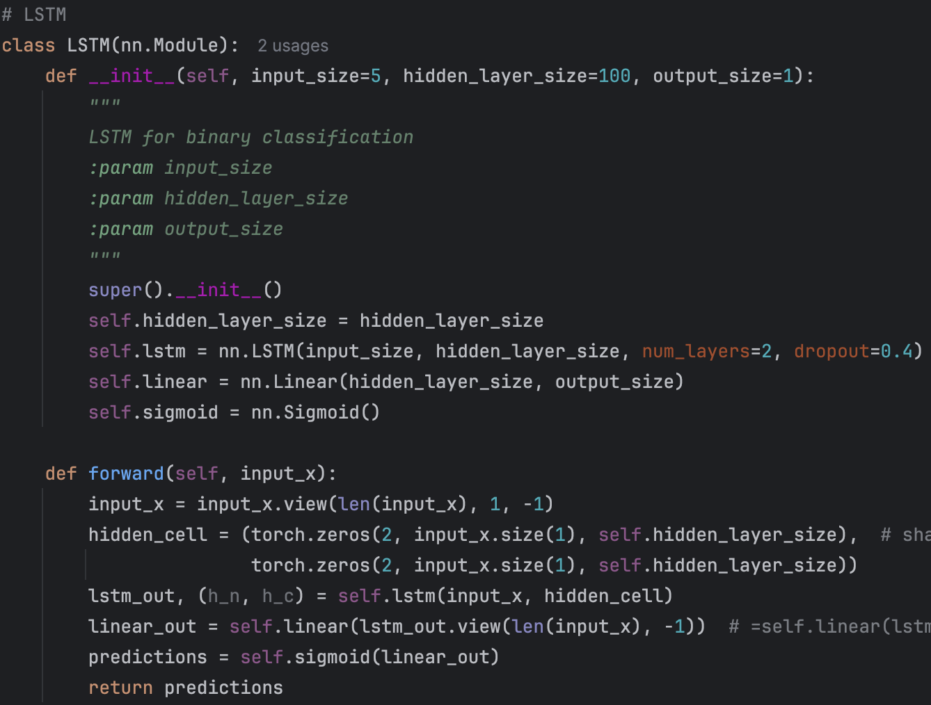
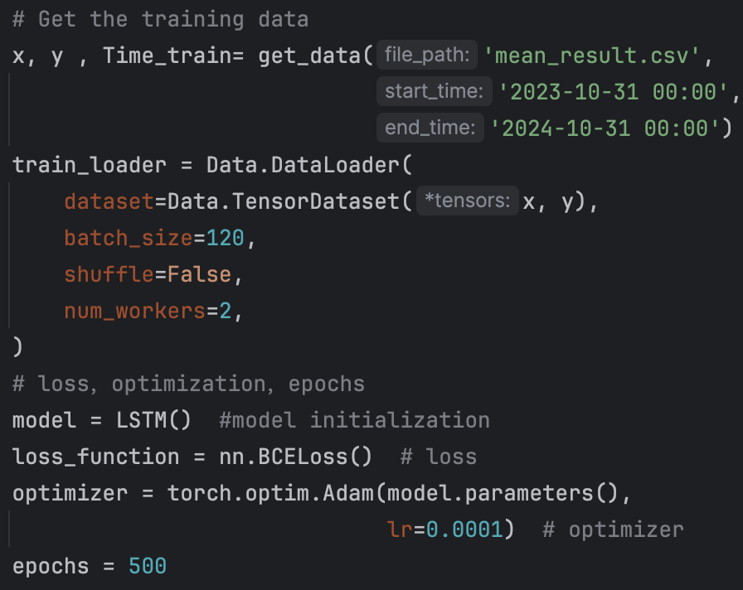
Coding – Modeling

Slide 13
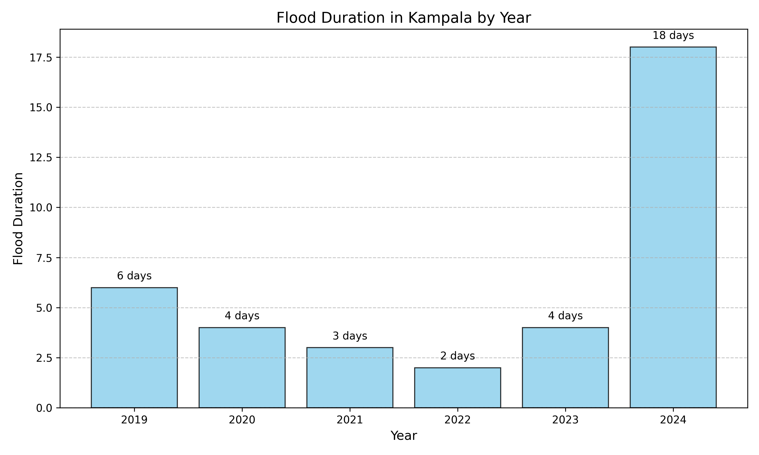
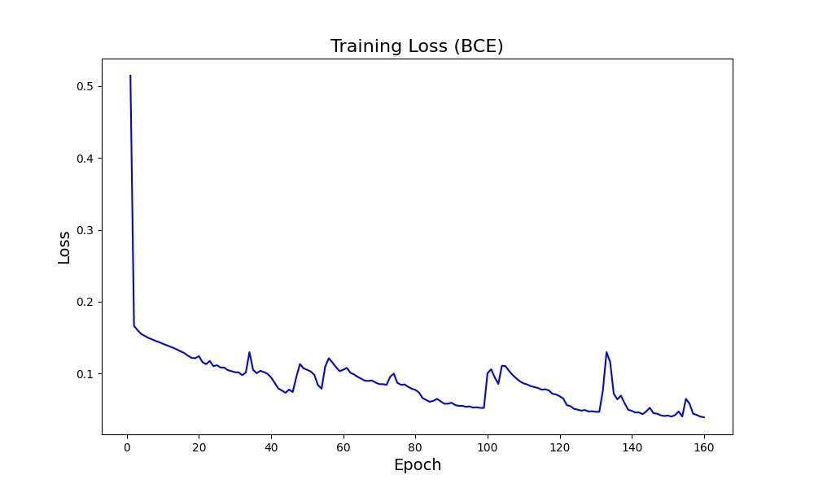
Coding – Training

Slide 14
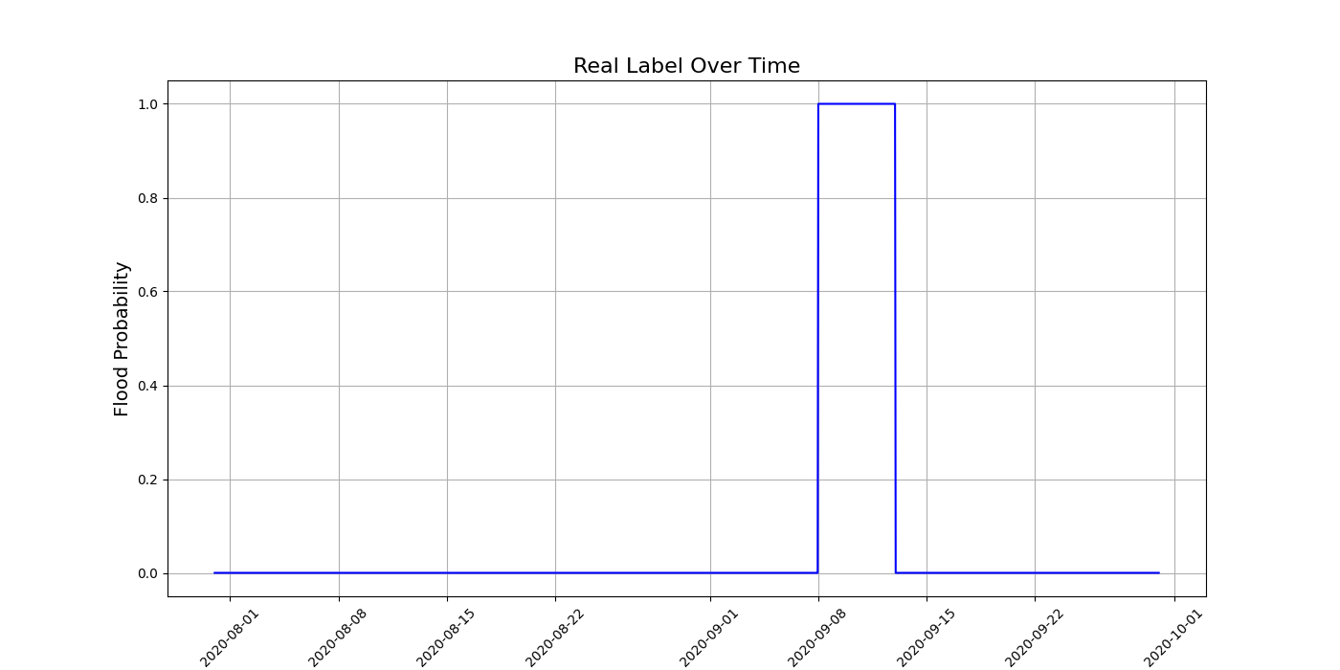
Coding – Testing 1
Testing Data 1:
2020-08-01 to 2020-10-01
Flood Duration:
2020-09-08 to 2020-09-12

Slide 15
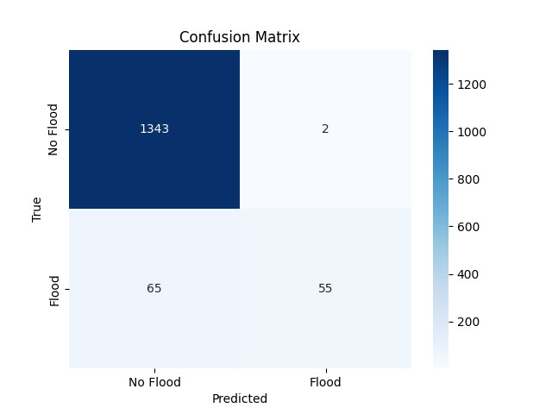
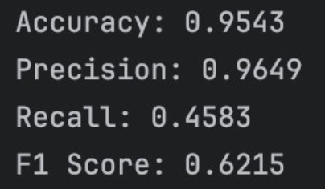
Coding – Testing 1
Evaluation Metrics

Slide 16
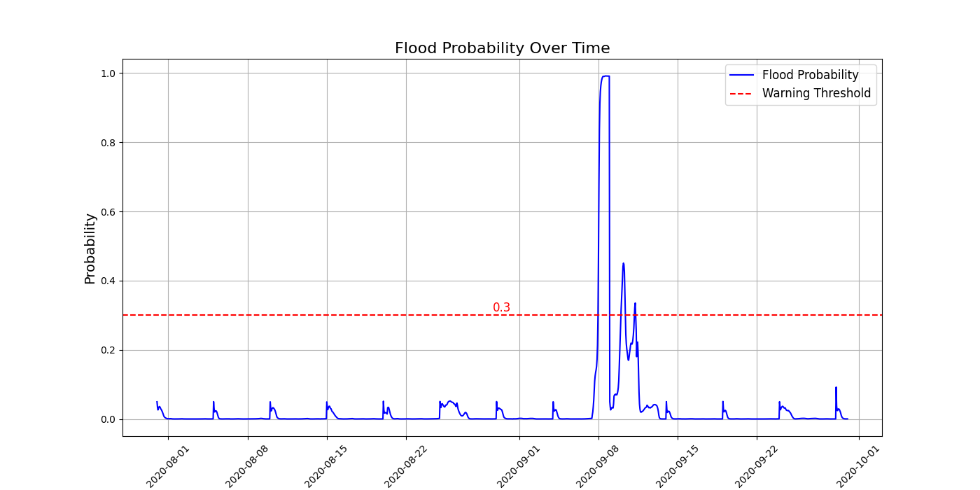
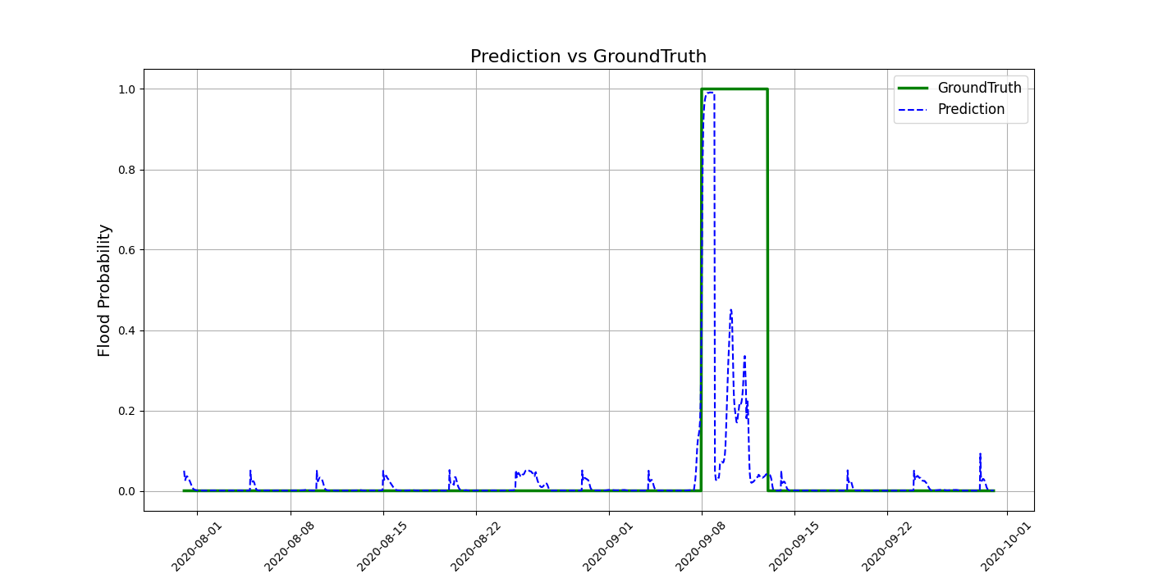
Coding – Testing 1
Prediction
Comparison

Slide 17
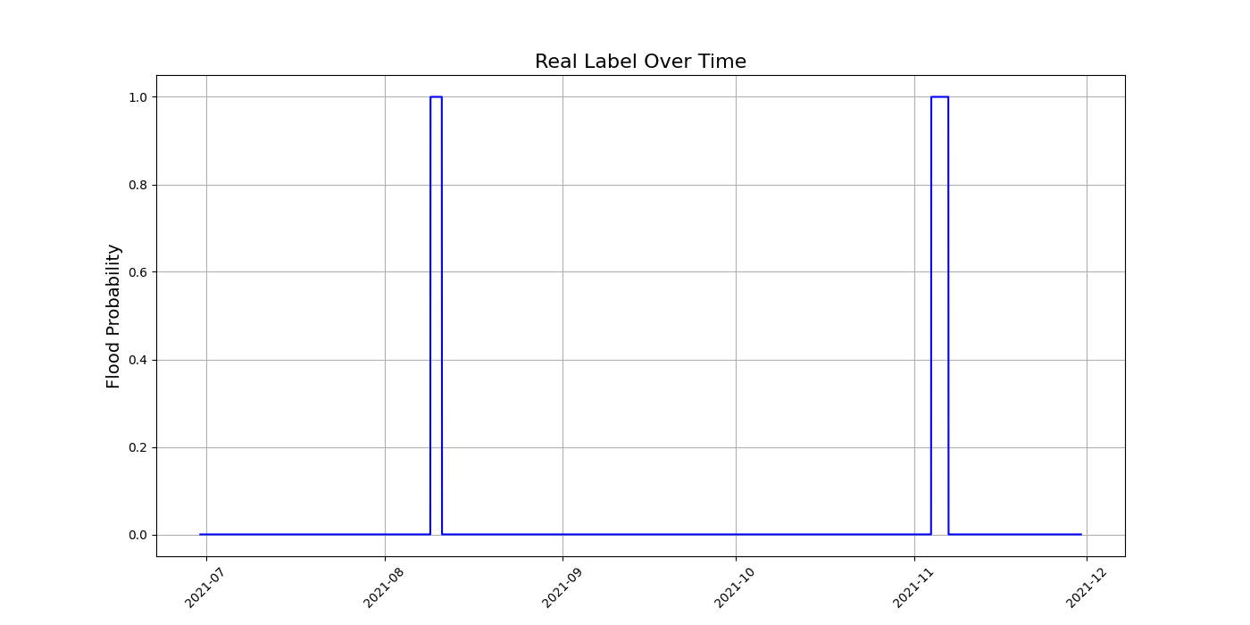
Coding – Testing 2
Testing Data 2:
2021-07-01 to 2021-12-01
Flood Duration:
① 2021-08-09 to 2021-08-10
② 2021-11-04 to 2021-11-06

Slide 18
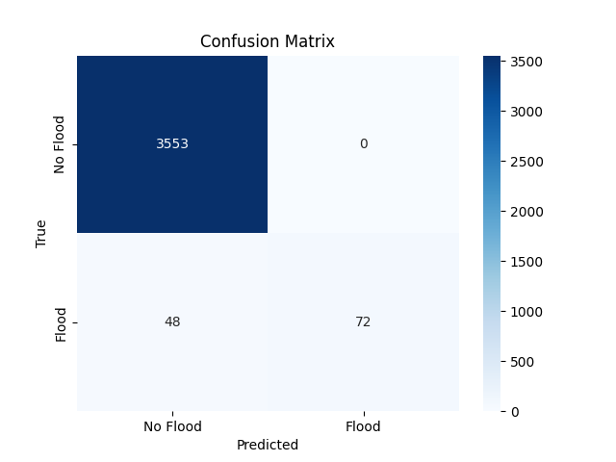
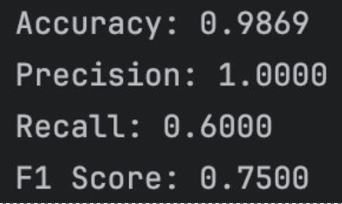
Coding – Testing 2
Evaluation Metrics

Slide 19
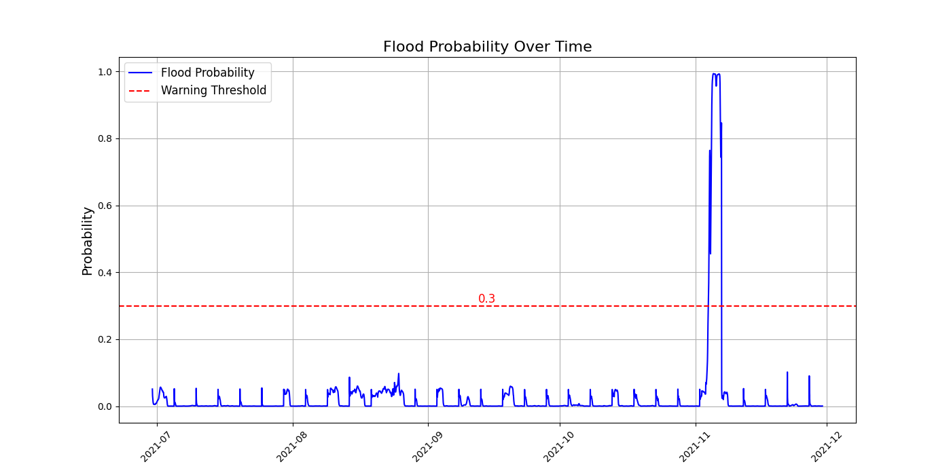
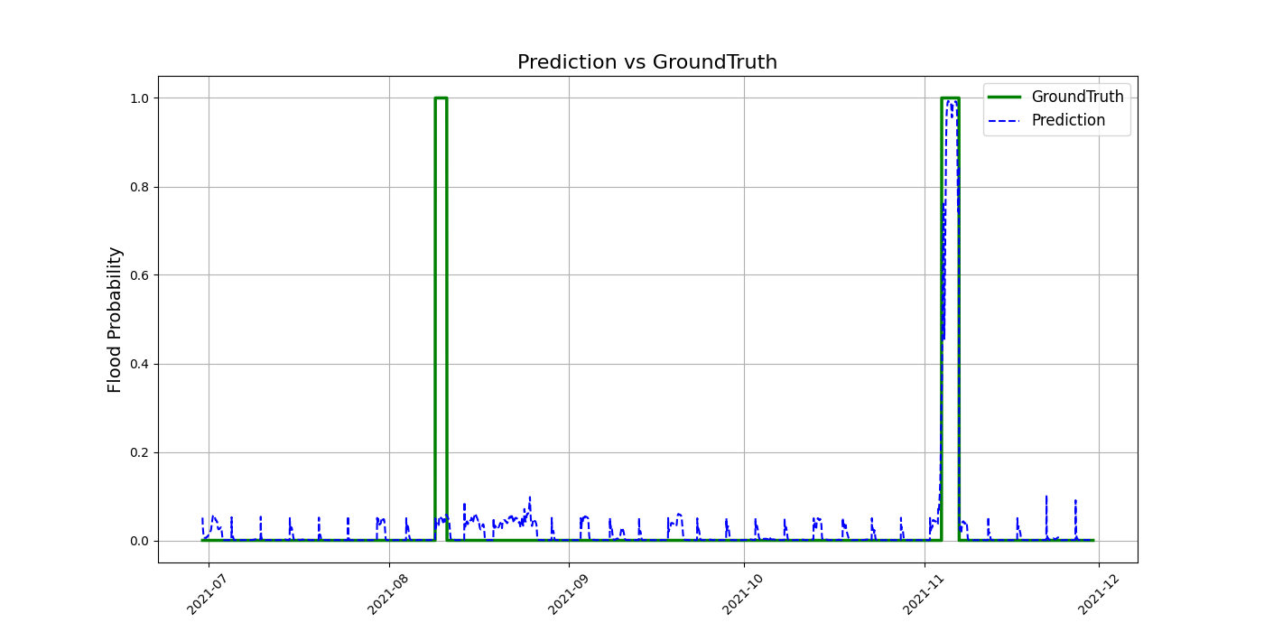
Coding – Testing 2
？
Prediction
Comparison

Slide 20
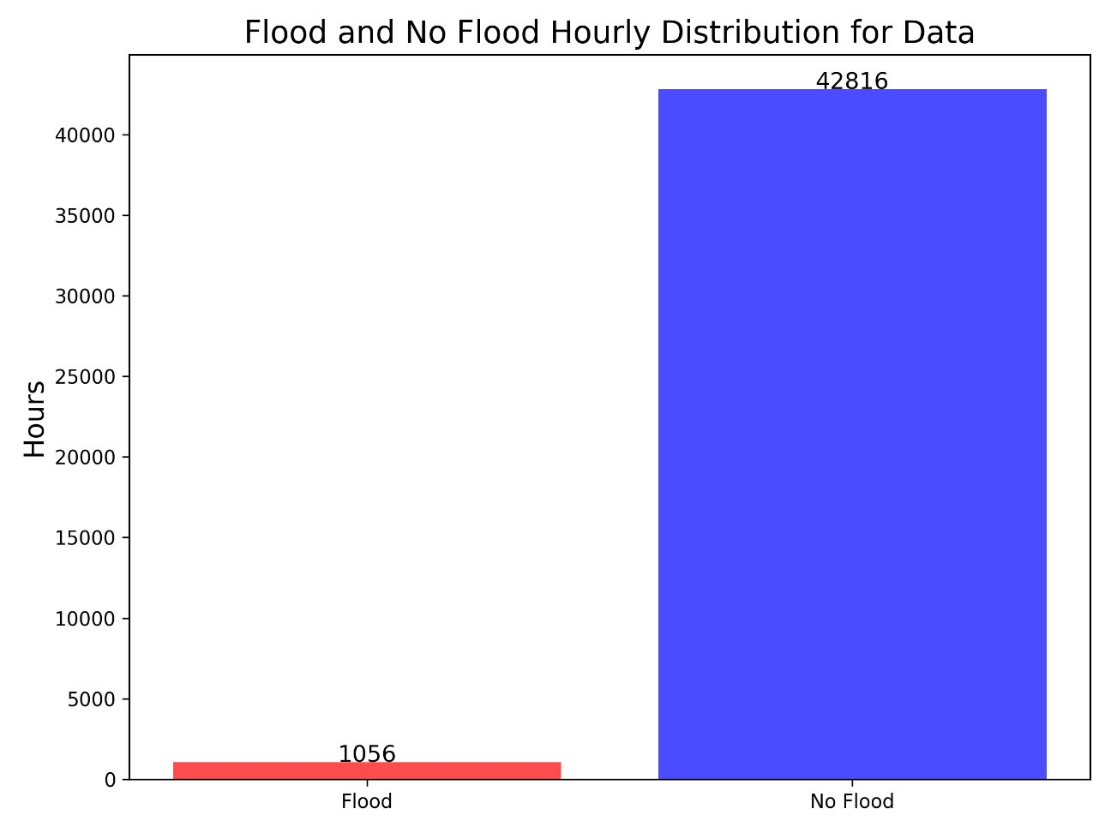
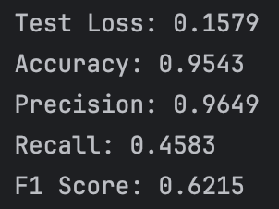
Discussion
Testing 1
Testing 2

Slide 21
Conclusion
Conclusion:
Our purpose was to develop a machine learning-based, early warning system for predicting flash floods and enhancing public safety in Kampala.
Despite the challenges; Deep Learning LSTM was a tool that allowed us to meet this purpose
Increasing the flood occurrence dataset to include all flooding, not just catastrophic flooding, could improve the performance of model on flooding data
Project Challenges:
Data acquisition was a significant challenge
Stream gauge data: non-existent
Flood data: UN database only contained catastrophic events not all flood events, so the imbalanced dataset was not perfect for training the model
Project Successes:
Innovative solution by using UN flood data in absence of stream gauge data to perform flood forecasting
Overall the model fit decent with high accuracy and precision
Recall and F1 score lower than ideal

Slide 22
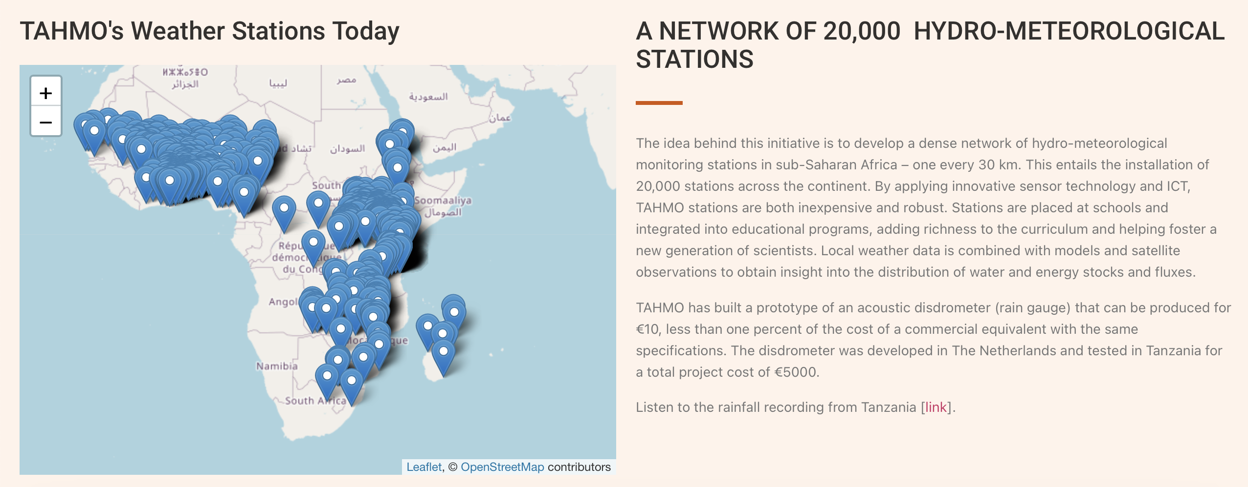
Acknowledgements:
We thank the Trans-African Hydro-Meteorological Observatory (TAHMO) for the provision of meteorological data.
Interested parties may contact info@tahmo.org for these data.

Slide 23
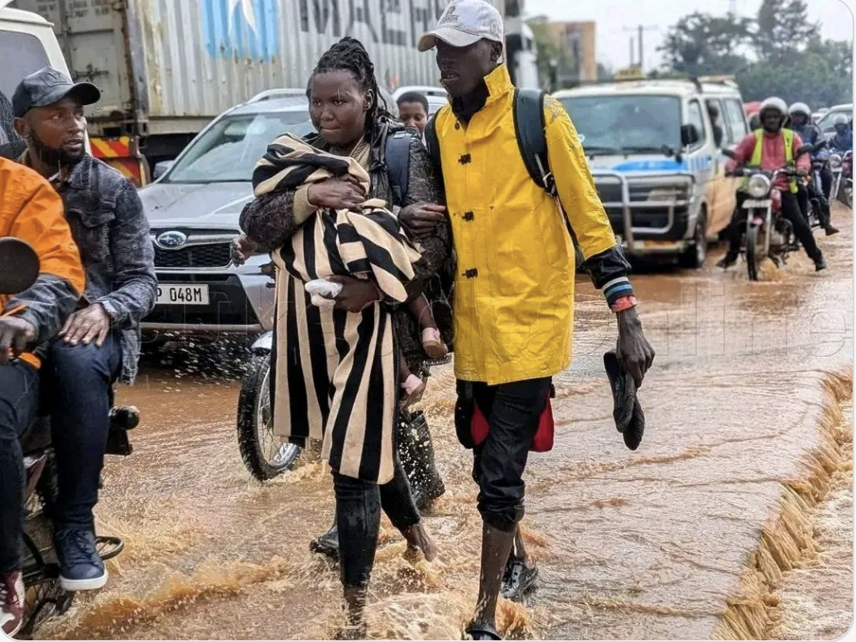
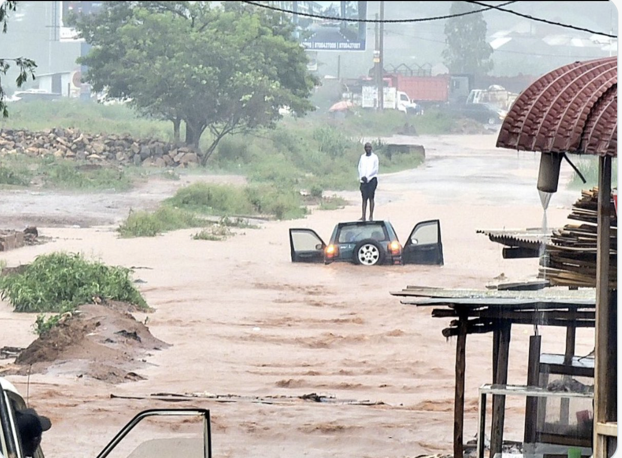
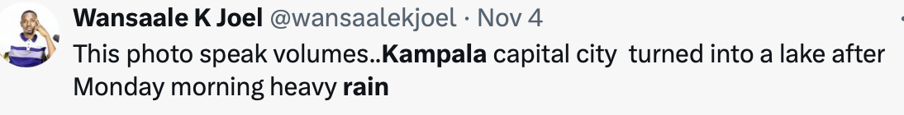
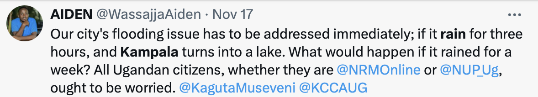
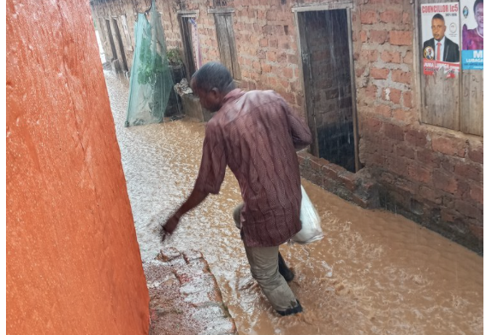
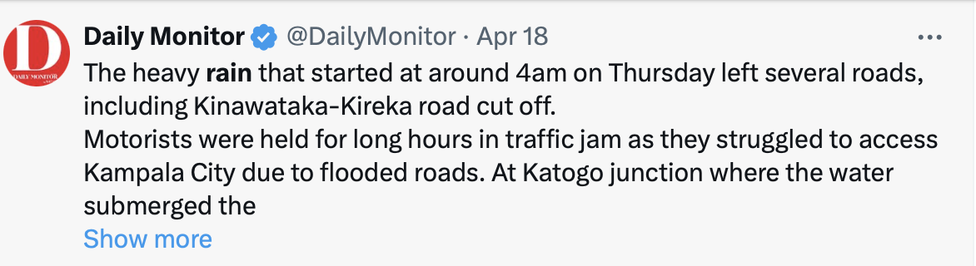
Questions?

